Slide 1


SOFTWARE DESIGN & ANALYSIS FINAL PROJECT’24
Productify

Slide 2
INTRODUCTION
Purpose: Its primary purpose is to allow users to compare products, check availability, analyze reviews, and explore second-hand products across platforms, all within a single interface.
The system will cater to a wide audience of online shoppers looking for convenience, efficiency, and better decision-making tools..

Slide 3
Scope
Productify is a web-based application designed to streamline the online shopping experience by aggregating product data from various e-commerce platforms like Amazon, AliExpress, and Newegg.
Its primary purpose is to allow users to compare products, check availability, analyze reviews, and explore second-hand products across platforms, all within a single interface. The system will cater to a wide audience of online shoppers looking for convenience, efficiency, and better decision-making tools.

Slide 4
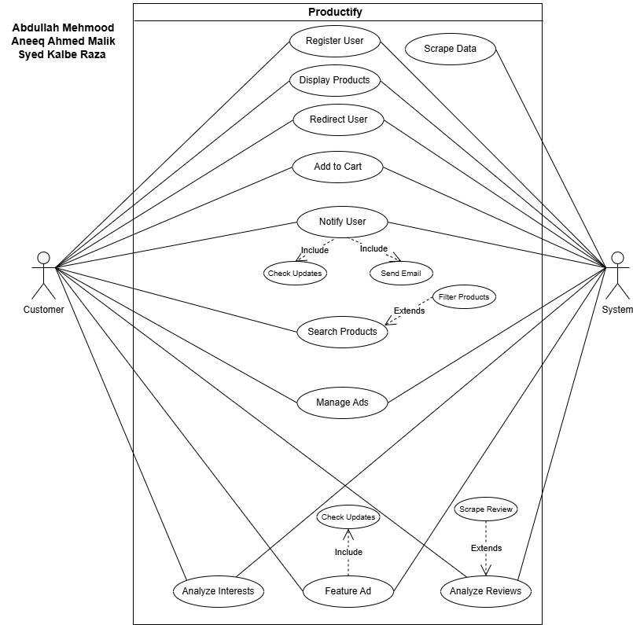

USE CASE DIAGRAM

Slide 5


NON-FUNCTIONAL REQUIREMENTS
Performance Requirements
•The system must respond to user actions (e.g., adding to cart, navigating, or searching) within
•The system must respond to user actions (e.g., adding to cart, navigating, or searching) within
Safety Requirements
•Prevent unintended data deletion by requiring confirmations before any permanent action (e.g., deleting ads).
BusinessRules
•Data Protection: Encrypt user data in transit (HTTPS) and at rest
•Regular security audits will be conducted to identify vulnerabilities

Slide 6

USER INTERFACES - DEMO

Slide 7
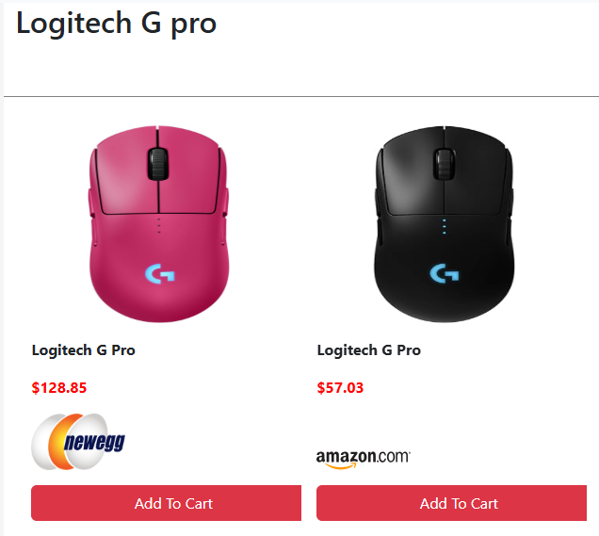
USER INTERFACES - DEMO
Price Comparison

Slide 8
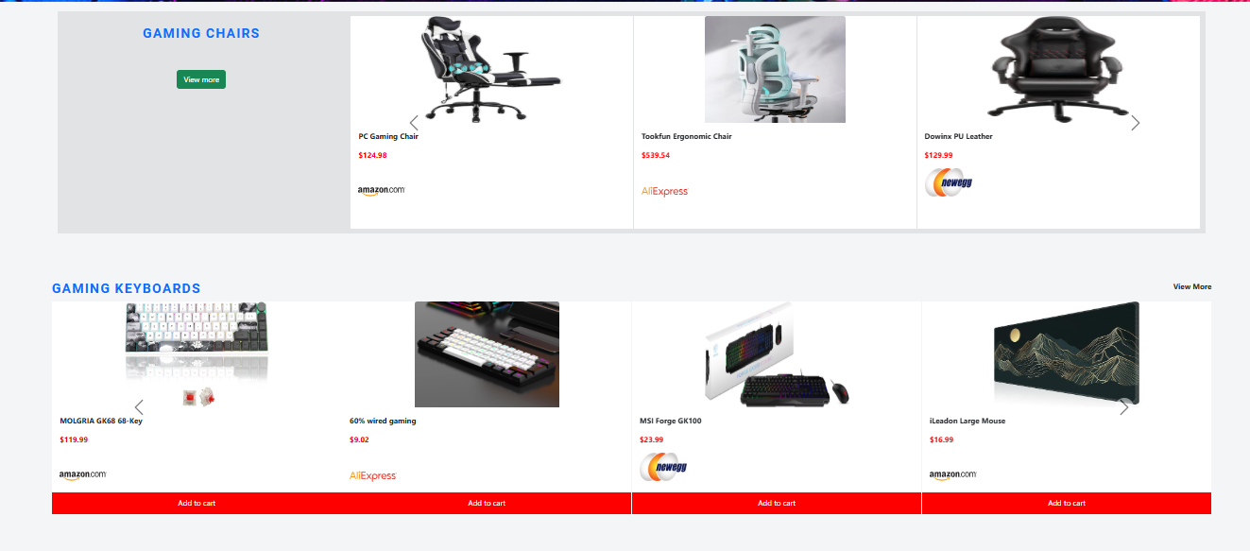
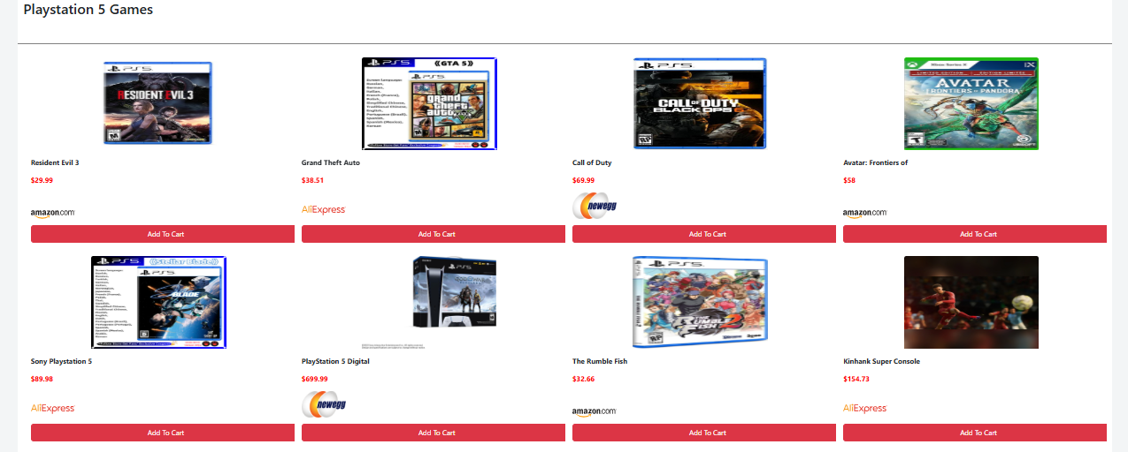
USER INTERFACES - DEMO

Slide 9
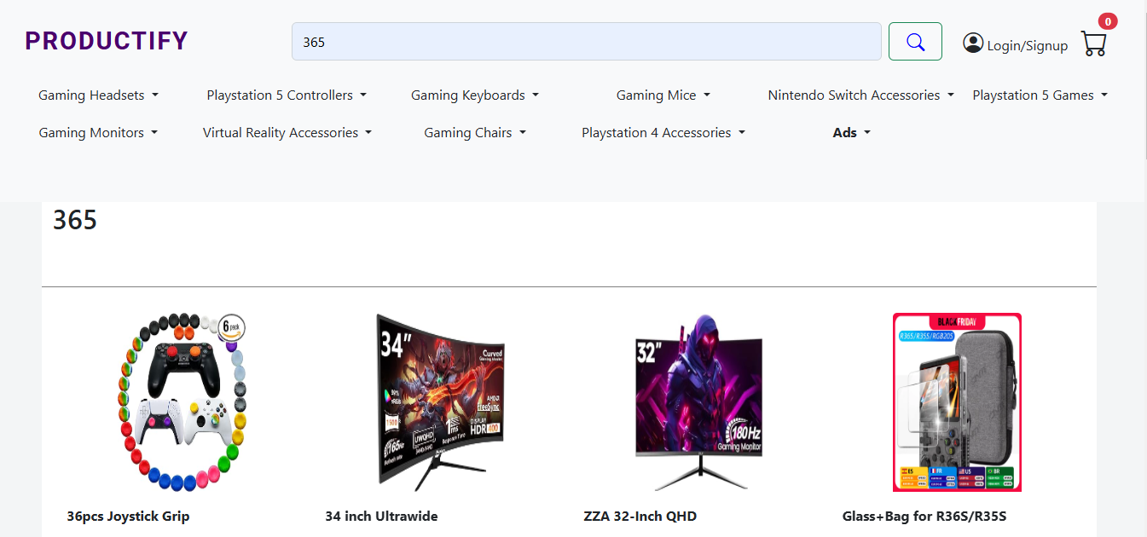
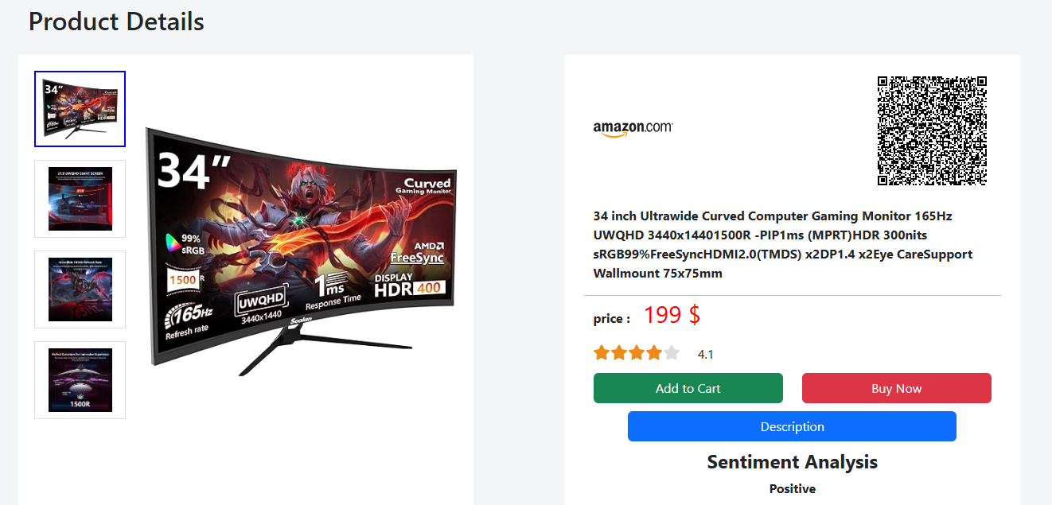
USER INTERFACES - DEMO

Slide 10
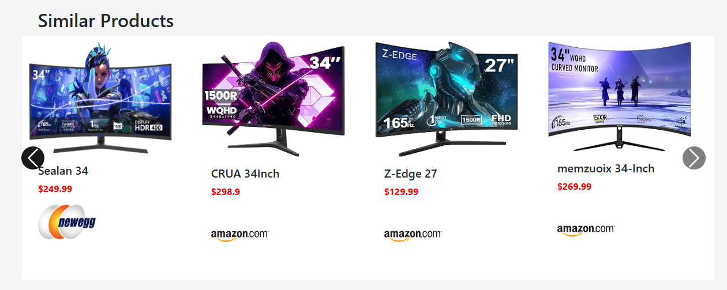
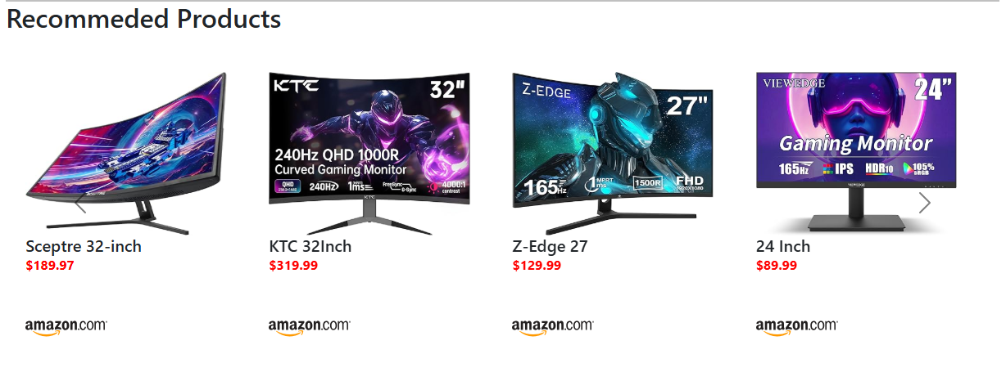
USER INTERFACES - DEMO

Slide 11
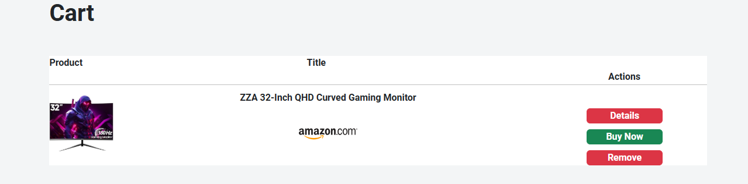
USER INTERFACES - DEMO

Slide 12
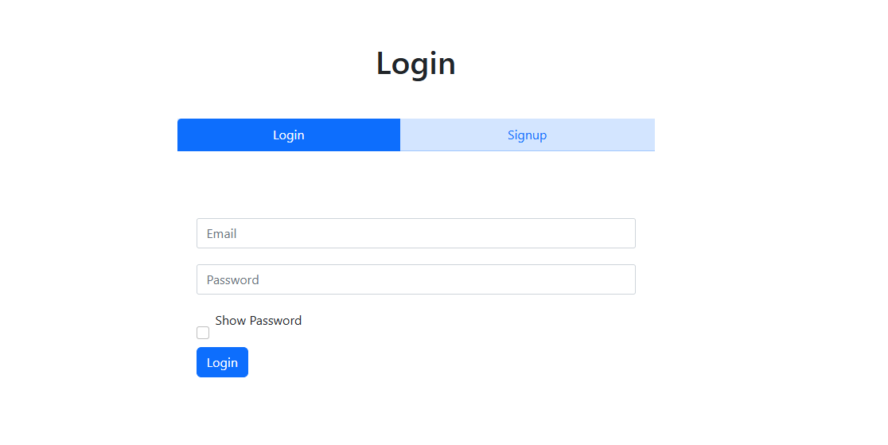
USER INTERFACES - DEMO

Slide 13
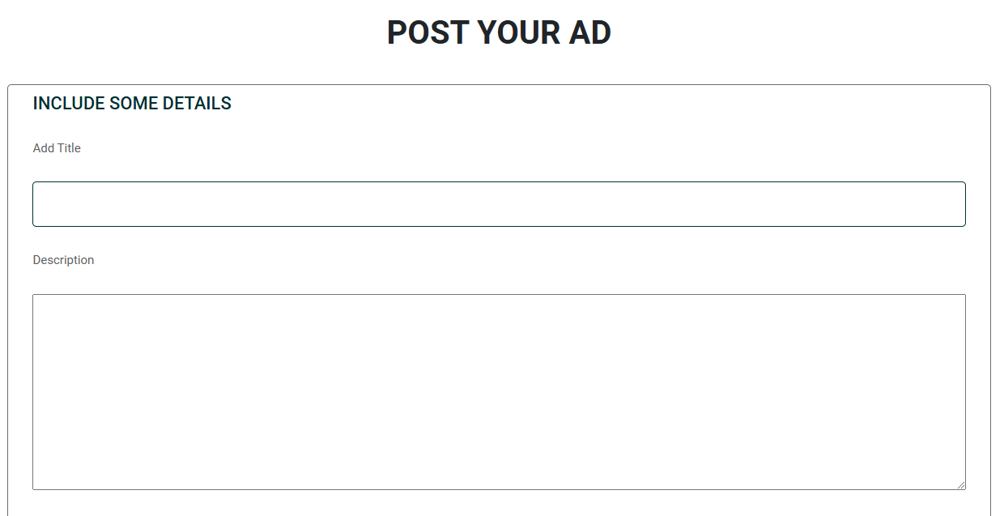
USER INTERFACES - DEMO

Slide 14
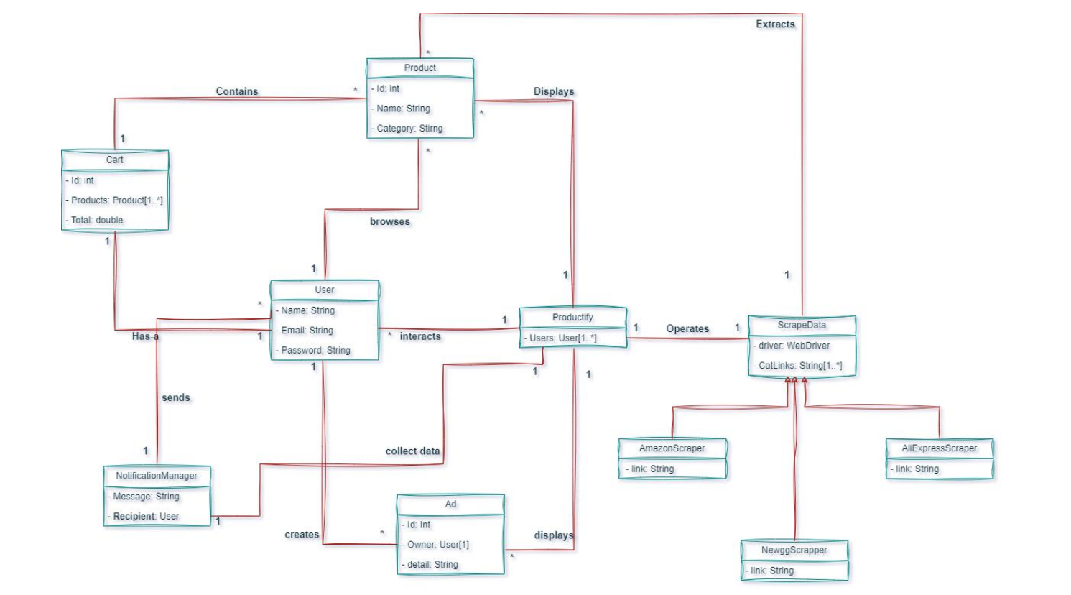
DOMAIN MODEL

Slide 15
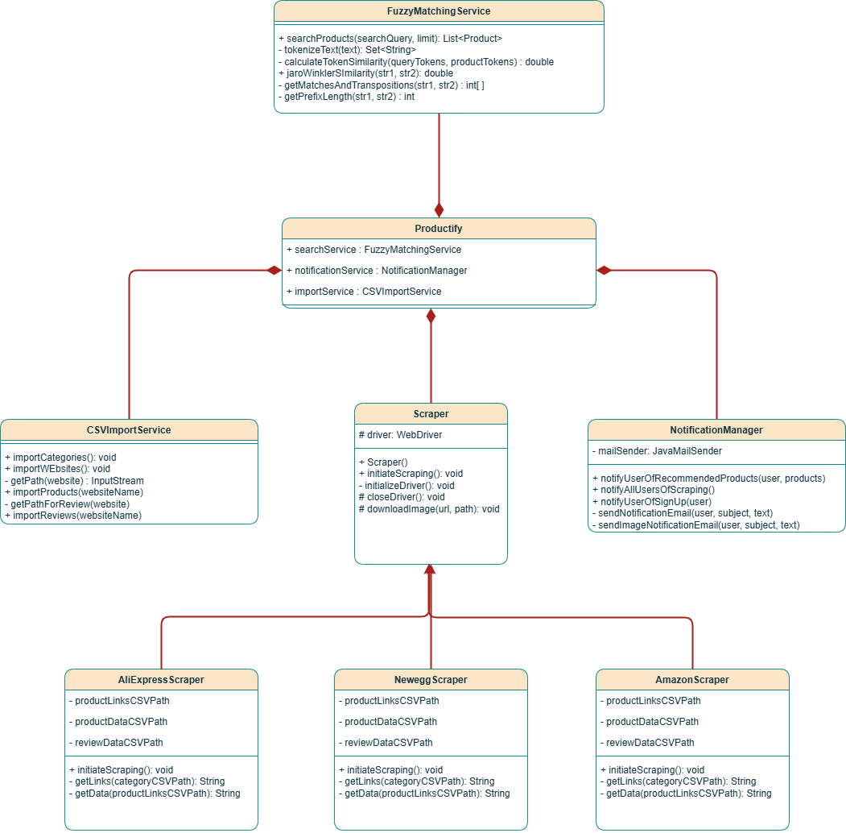
CLASS DIAGRAM

Slide 16
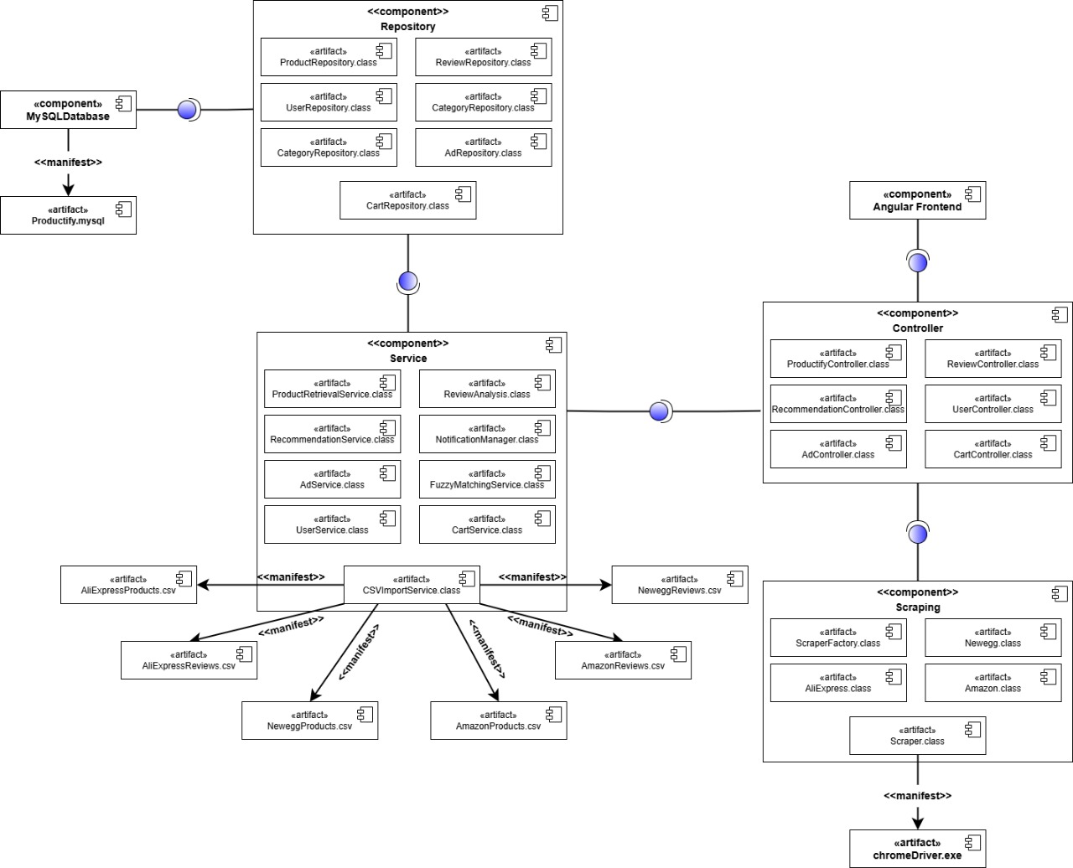
COMPONENT DIAGRAM

Slide 17
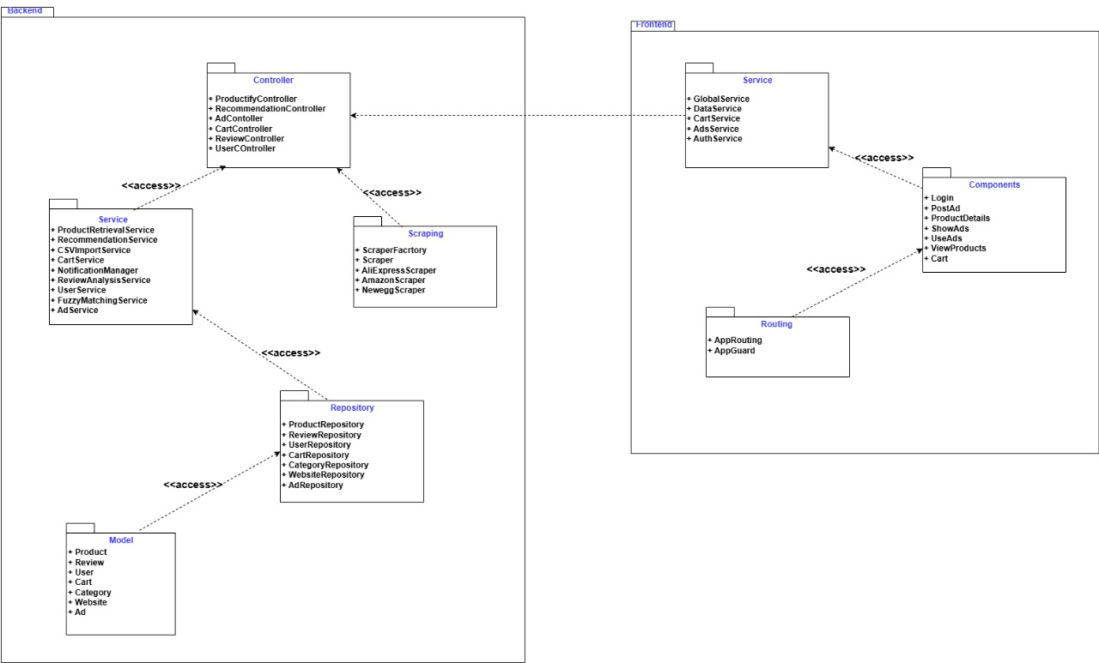
PACKAGE DIAGRAM

Slide 18
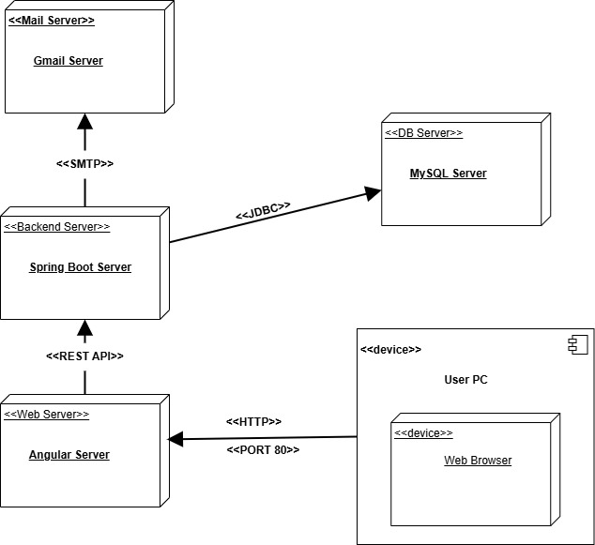
DEPLOYMENT DIAGRAM

Slide 19

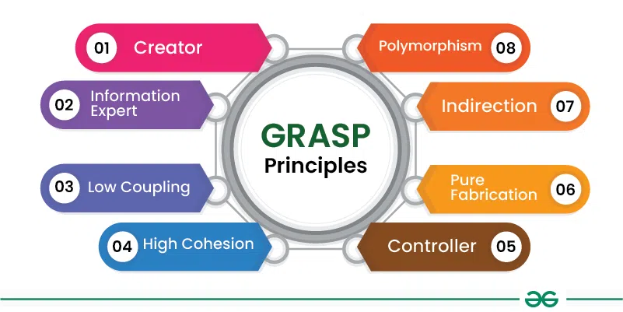
DESIGN PATTERNS USED

Slide 20
DESIGN PATTERNS USED
GOF Patterns
Observer
Singleton
Factory

Slide 21
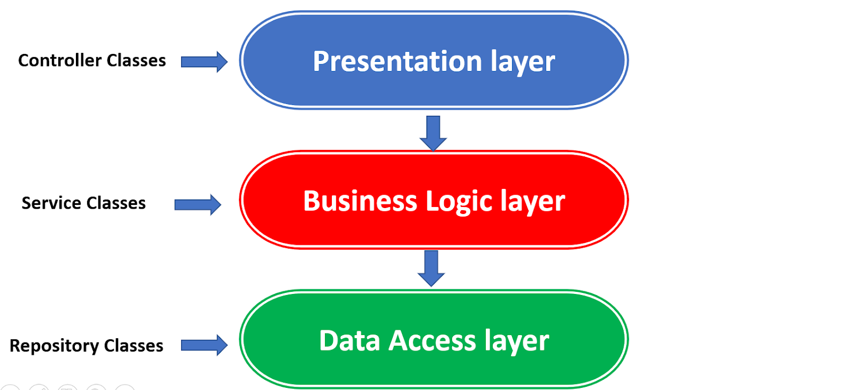
Three-Layer Architecture

